Slide 1
Effects of Mean Free Path and Neutron Lifetime on N.C. State’s Ultra-Cold Neutron Source
Jonathan Coburn
3/20/2012

Slide 2
Project Specifications
Start with given source geometry files
Vary Neutron Lifetime between 25 & 75 ms
Vary Mean Free Path between 1 & 6 cm
Observe the fraction of surviving neutrons
Make plots showing how and where UCN interacted
Observe any significant differences in behavior

Slide 3
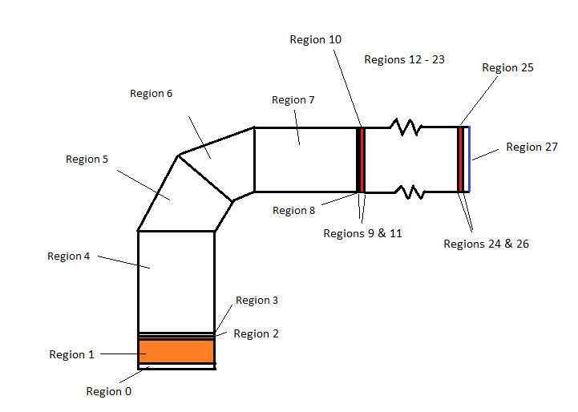
Sketch of source geometry

Slide 4
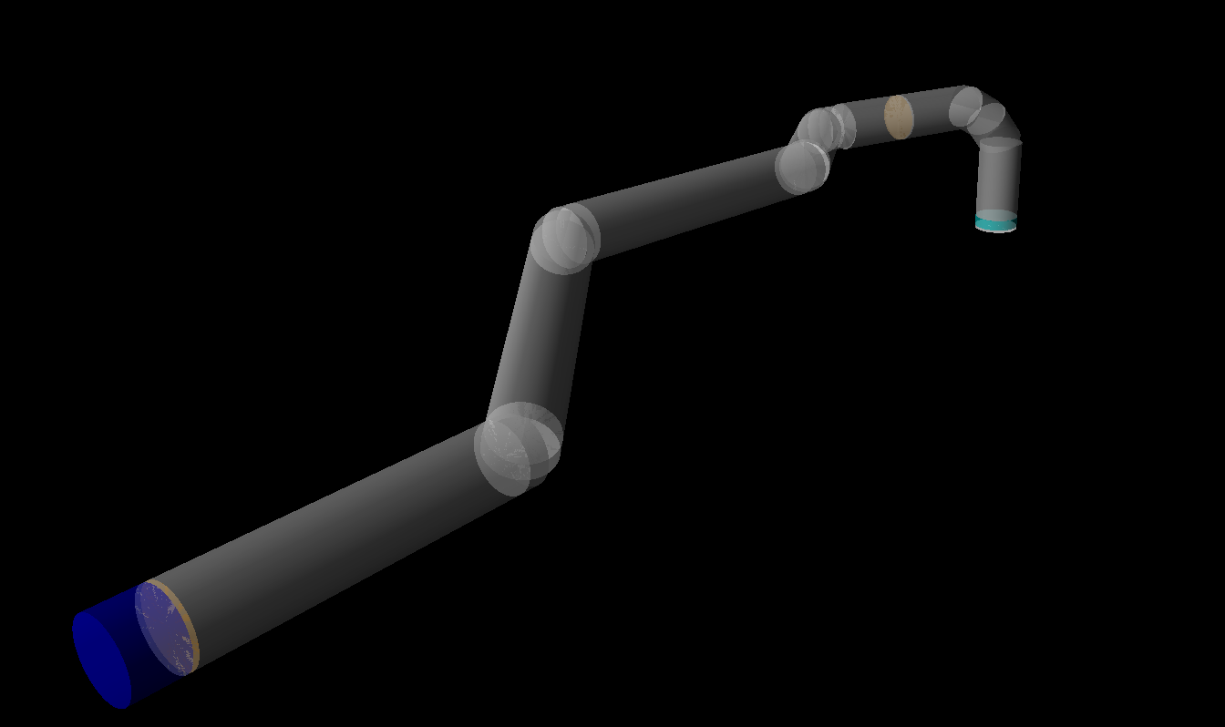
VPython Visualization of Source Geometry

Slide 5
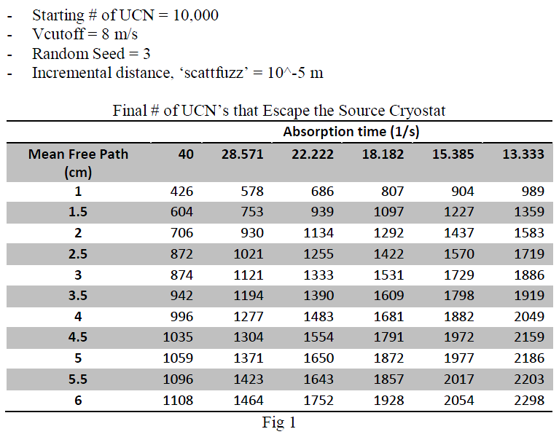
Results from using UCNTransport, Version 29.9

Slide 6
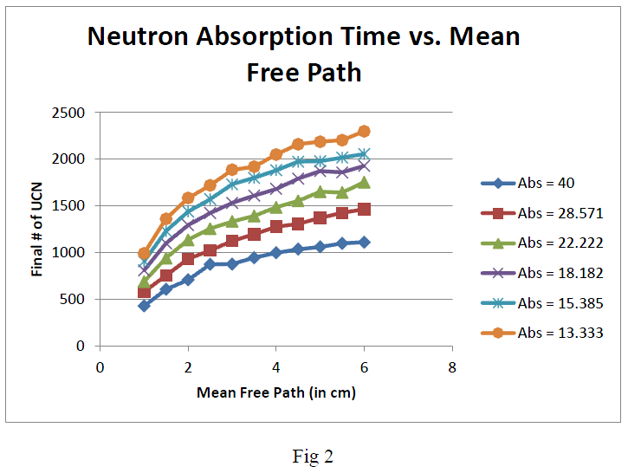

Slide 7
Data Summary:
By increasing neutron lifetime, the number of surviving UCN increases
By increasing mean free path, the number of surviving UCN increases
For reasonable values of MFP = 4cm and lifetime = 45 ms,
surviving UCN fraction = 15%
Interesting note: for individual lifetimes, the function of mean free path vs. surviving # of UCN is parabolic in nature

Slide 8
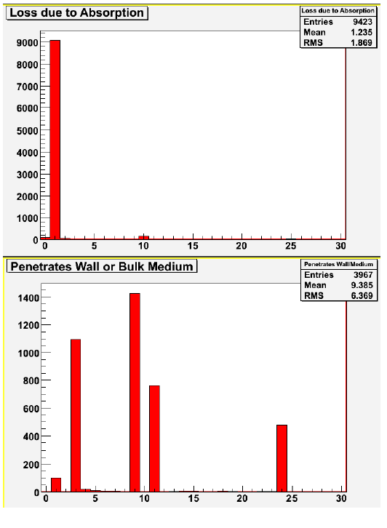
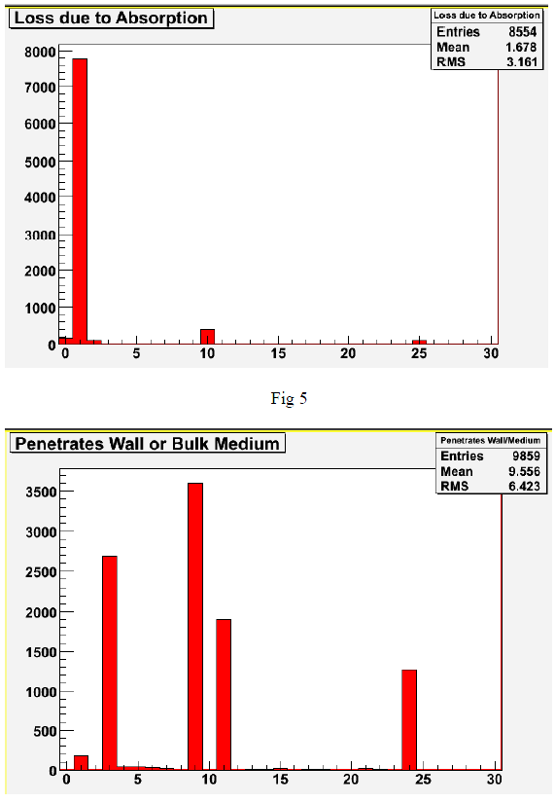

Slide 9
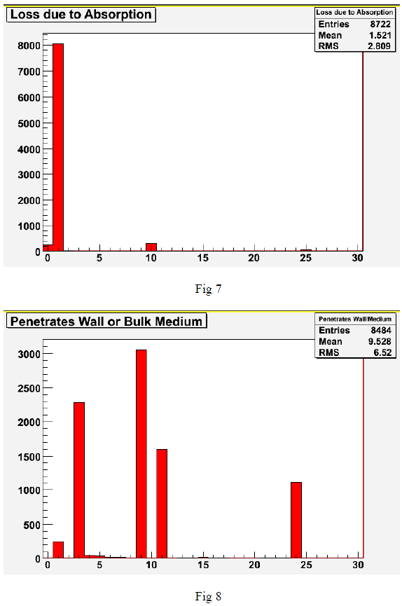
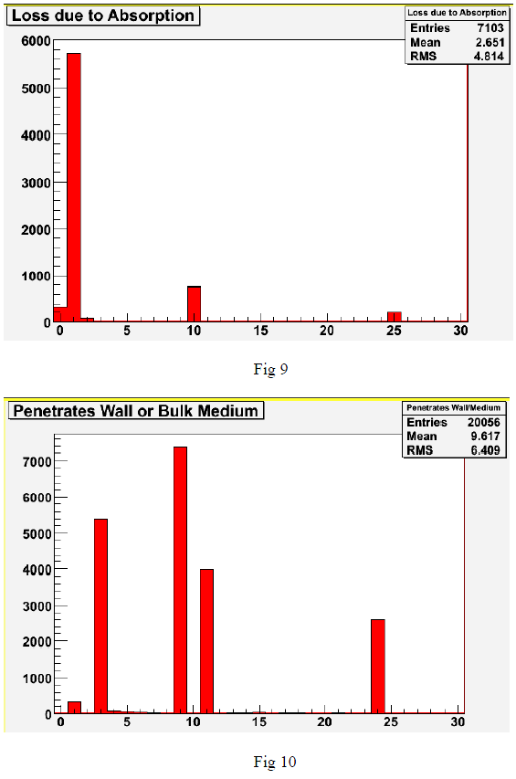

Slide 10
Histogram Data Summary:
‘loss due to absorption’ accounts for any neutron that is lost in any region due to absorption (except detectors)
‘penetrates wall or bulk medium’ accounts for
Neutrons lost due to penetration of a region
Any time a particle penetrates a bulk medium
Overall, results are proportionally similar for each situation.

Slide 11
Conclusion and Future Goals
Goal: Maximize the mean free path and neutron lifetime parameters
Ways to improve results:
Re-run experiment with higher initial counts of UCN, to improve accuracy
Create more specific histogram plots
New Goals:
Investigate whether final UCN count approaches a maximum as mean free path increases
Measure steady state neutron density within system

